Slide 1
dotnet build Customizing your csproj
Seth Valdetero
SQL Saturday 2024

Slide 2
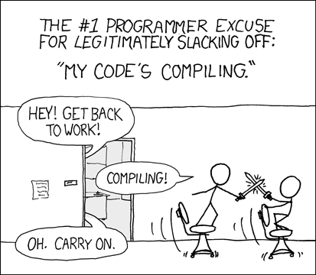
https://xkcd.com/303/

Slide 3
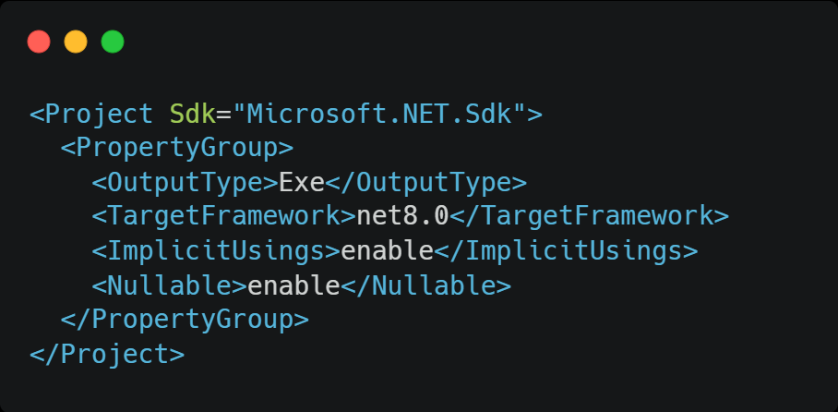

Slide 4
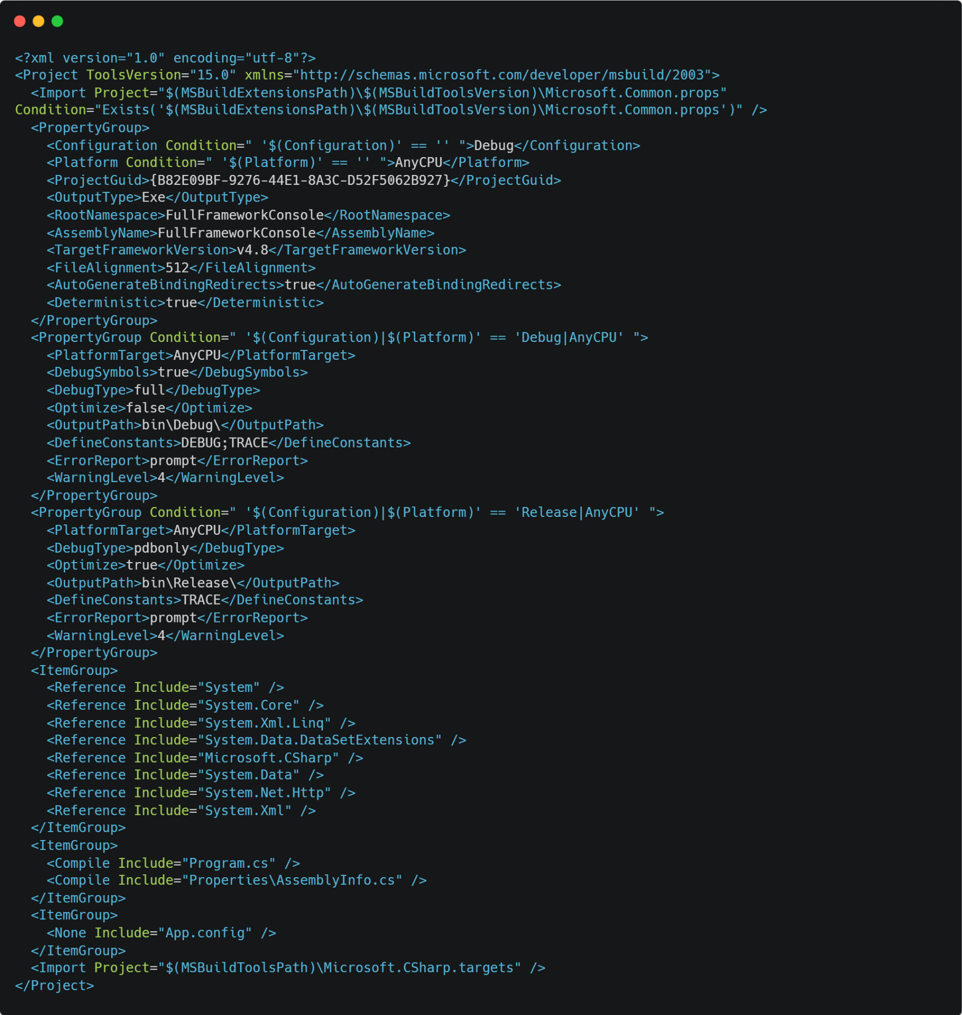

Slide 6
<code demo>
Notes:
PropertyGroup
Only set once
Only string values
No access modifiers

Slide 7


Slide 8

Questions?
https://github.com/valdetero/Presentations/tree/main/dotnetbuild

